Slide 1



What Now?
Week 3 Report
Ethan Janovich, Sam Persinger, Lavender Wilson

Slide 2


Week 3 Progress

Slide 3
So far…
We finished document scanning support, including popups to verify scanned text and the AI generated events.
Voice input now correctly converts recorded conversation to text.
Several types of calendar events are now representable.

Slide 4
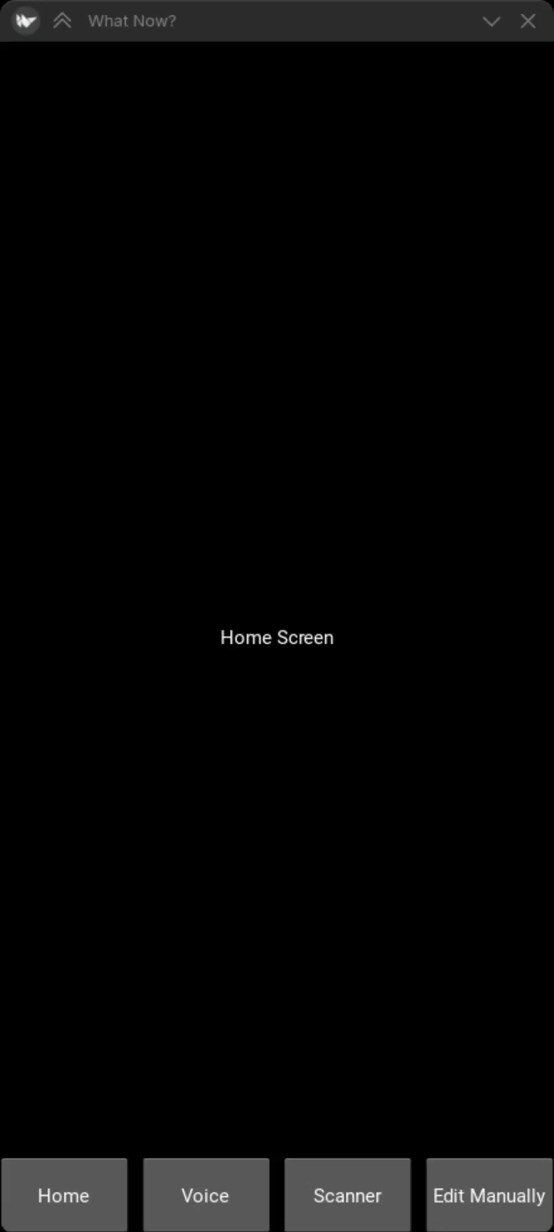
Demo of DocumentScanner
Verify scanned text
Generate JSON with generative AI (working on getting the time down from about 45 seconds currently)
Popups confirming the generated events

Slide 5
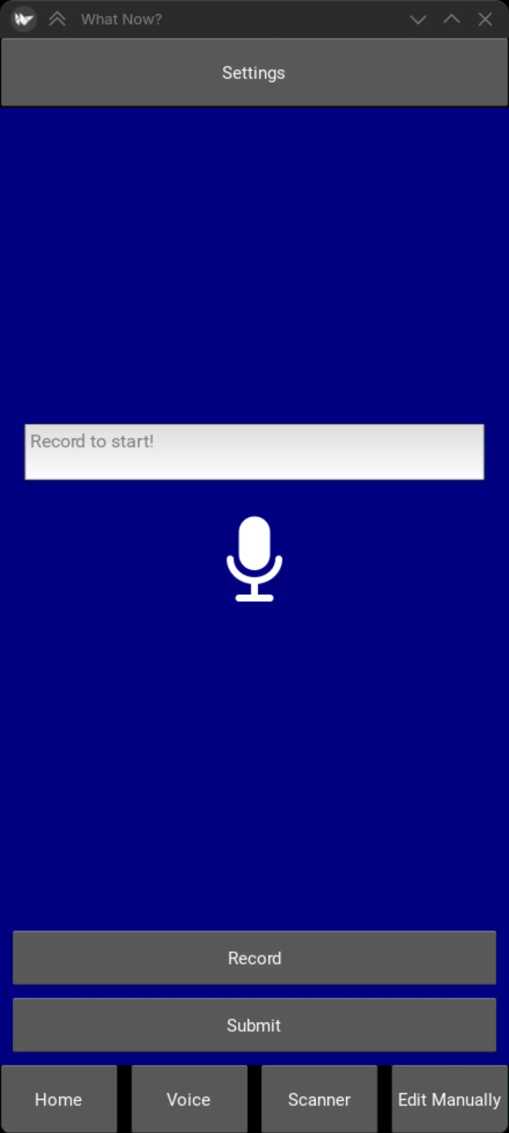
Demo of VoiceInput
Live text view of spoken words
TextBox to fix mis-detected words
Submit button needs to be connected to the CommandHandler once its written.

Slide 6
Challenges
UI issues with popups for the DocumentScanner class
Git Issues with the issue tracker. It currently doesn't show the pull requests, even though we are pretty sure it supports it.
Issue getting the voice recording to stop immediately.

Slide 7
Gantt chart
We are currently on pace with our Gantt chart.
Our current estimates give us about 2 weeks of wiggle room for unexpected problems to push us into.

Slide 8
Website
We will be storing all our documents, including reports, on this website: https://spersinger.github.io/what-now-website/

Slide 9

Next Steps
This week we will be working on implementing the Schedule and starting the CommandInterpreter class
We will also be cleaning up the classes we already wrote and making them ready to integrate properly with the new classes we are writing

